Slide 1
Bank Loan Case Study
Zaid Mohammad

Slide 2
Project Description
This project focuses on analyzing loan application data to help financial institutions make smarter, data-driven decisions about approving or rejecting loans. By using Exploratory Data Analysis (EDA), we aim to uncover patterns and key indicators that predict whether a customer is likely to default. This helps minimize financial losses from risky approvals and prevents the rejection of creditworthy applicants, ultimately improving the efficiency and profitability of the loan approval process.

Slide 3
Tech Stack
MS - Excel
PowerPoint

Slide 4
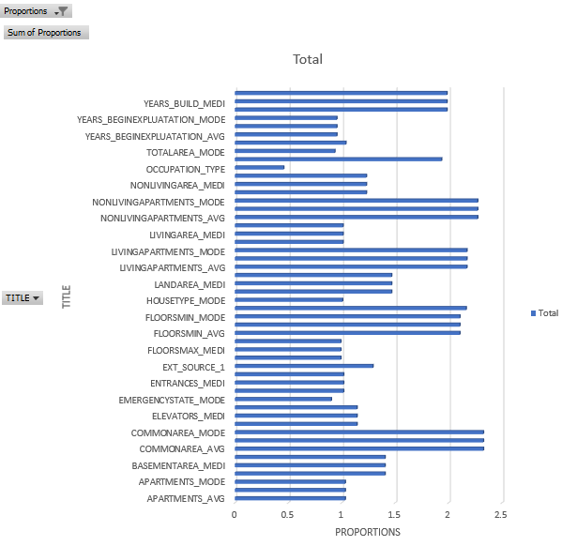
A. Data Cleaning
Identified missing values across all columns using COUNTBLANK
Calculated proportion of missing data using:
=COUNTBLANK() / COUNTA()
Filtered out columns with more than 40% missing values
Filled missing values in:
Numerical columns using MEDIAN
Categorical columns using most frequent value MODE
Transformed layout to highlight key missing columns
Visualized missing proportions using a bar chart
Result:
Cleaned dataset reduced to ~73 columns
Ready for deeper analysis
Columns with > 40% Null values

Slide 5
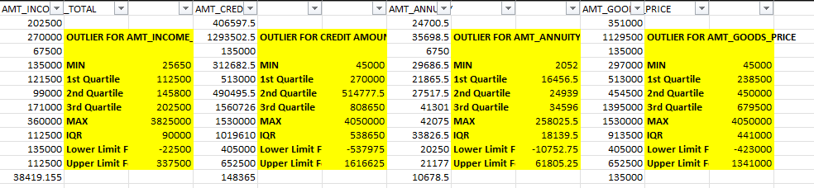
B. Outliers
Some people applied for very large loans, which could be risky for the company.
A few applicants reported extremely high incomes that don’t look realistic and can mess with the averages.
There’s a weird value in job history (like 365243 days worked) that’s just a placeholder and not real.
Overall, there’s a lot of variation in things like income, loan amount, and job history which means there are unusual cases the company should watch closely.

Slide 6
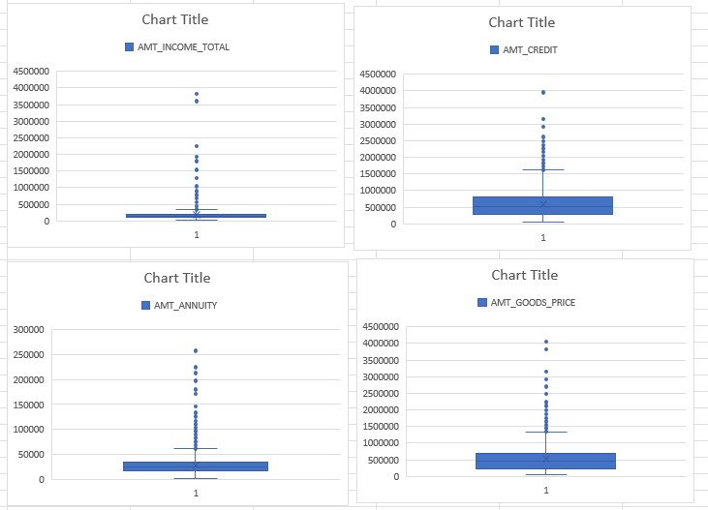

Slide 7
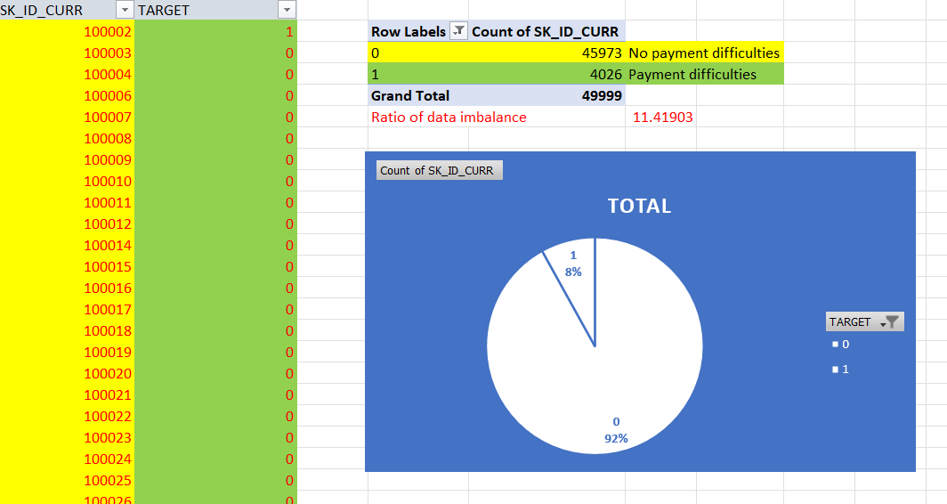
C. Data Imbalance
The loan application dataset is imbalanced.
Using COUNT in the Pivot table, we found:
Majority class (TARGET = 0) has 45,973 entries.
Minority class (TARGET = 1) has only 4,026 entries.
Total entries = 49,999
Imbalance ratio = 45,973 / 4,026 ≈ 11.42
92% of applicants had no payment difficulties.
Only 8% had payment difficulties.

Slide 8
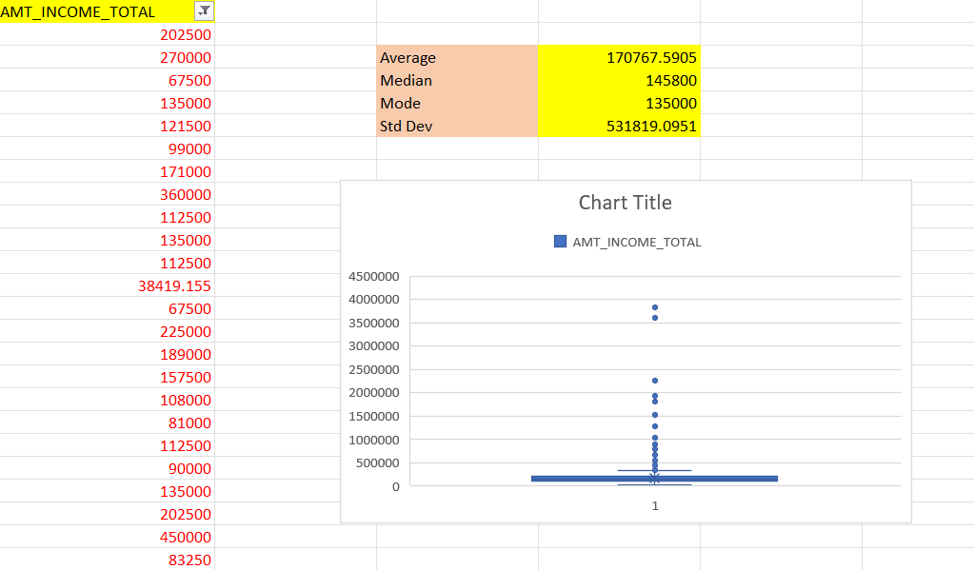
D. Analysis
Univariate Analysis
(Overall Income)
The average income of applicants is approximately ₹170,767.
The median income is ₹145,800, which is lower than the average indicating a right-skewed distribution.
The mode (most frequent income) is ₹135,000, showing a common income level among many applicants.
The standard deviation is quite high (~₹531,819), suggesting significant income variability and presence of outliers.
A box plot further confirms the existence of a few high-income outliers.

Slide 9
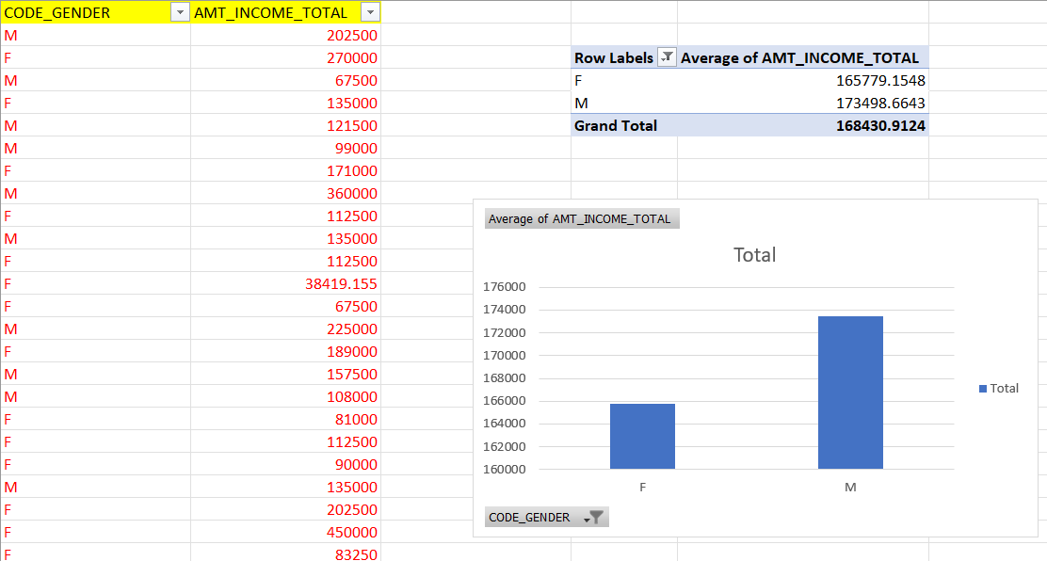
Segmented Univariate Analysis
(Income by Gender)
Average income for males: ₹173,499
Average income for females: ₹165,779
Males earn ~4.7% more on average than females.
The income gap between genders is relatively small, but noticeable.
This segmentation helps understand how gender may influence financial capacity in loan analysis.

Slide 10
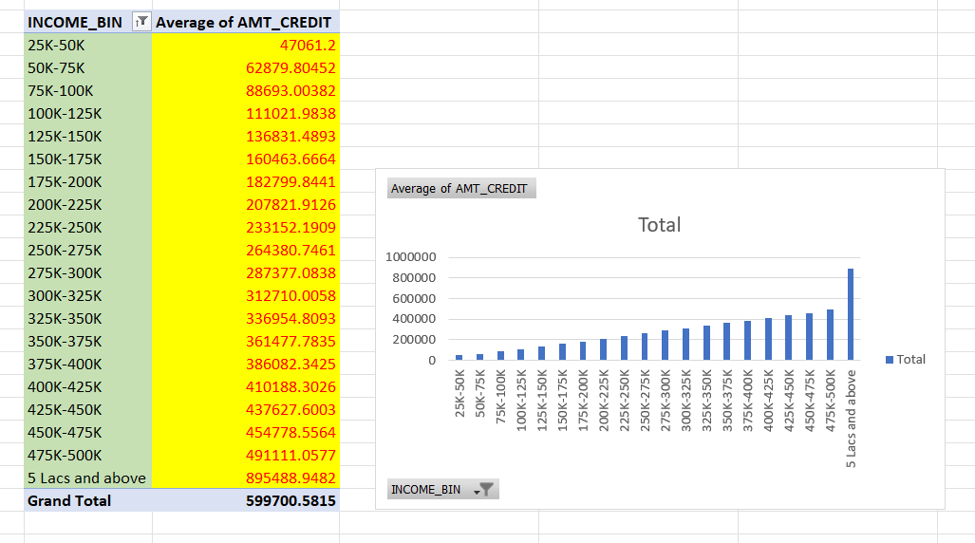
Bivariate Analysis
(Income vs Credit Amount)
Avg. credit across all applicants: ~₹5.99 Lakhs
Credit rises with income – higher earners get bigger credit amounts
Highest avg. credit (~₹8.95L) seen in "5 Lacs and above" group
Lowest avg. credit (~₹47K) in "25K–50K" group
Steady increase across bins shows a strong income-credit link

Slide 11
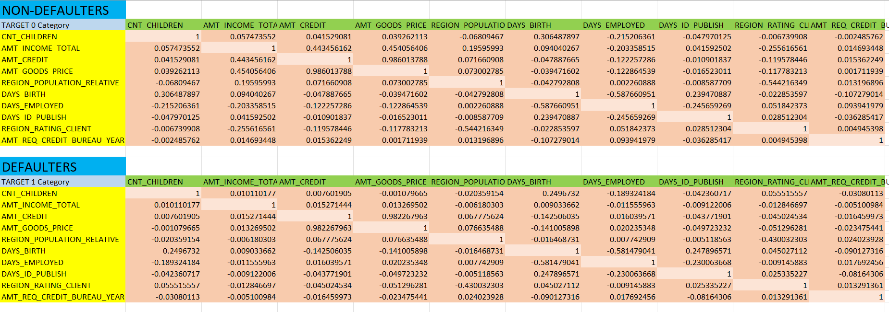
E. Correlations

Slide 12
Non-Defaulters (Target 0)
AMT_CREDIT and AMT_GOODS_PRICE have a very strong positive correlation (0.986) — expected, as loan amounts are highly tied to the cost of the goods.
AMT_INCOME_TOTAL and AMT_CREDIT have a moderate correlation (0.443) — higher income people tend to take larger loans.
DAYS_BIRTH and DAYS_EMPLOYED show a moderate negative correlation (-0.587) — older people tend to have fewer active employment days remaining.
REGION_POPULATION_RELATIVE and REGION_RATING_CLIENT have a noticeable negative correlation (-0.544) — people from more populated areas tend to have slightly worse region ratings.
Defaulters (Target 1)
AMT_CREDIT and AMT_GOODS_PRICE remain highly correlated (0.983) — again showing loan amount is tied closely to goods value.
DAYS_BIRTH and DAYS_EMPLOYED have a strong negative correlation (-0.581) — consistent with non-defaulters, older defaulters also work less.
REGION_POPULATION_RELATIVE and REGION_RATING_CLIENT show a stronger negative correlation (-0.430) compared to non-defaulters — suggesting defaulters are more concentrated in high population, lower-rated regions.
CNT_CHILDREN and DAYS_EMPLOYED show a strong negative correlation (-0.183) — families with more kids may face employment instability.
DAYS_ID_PUBLISH and DAYS_EMPLOYED correlation becomes more negative (-0.230) — possibly reflecting unstable document verification timelines among defaulters.

Slide 13
Insights
Data cleaning was handled appropriately by removing columns with >40% missing values and using median/mode imputation for remaining missing data
Outlier detection was performed with a focus on income amounts
Data imbalance was properly identified (92% non-defaulters vs 8% defaulters)
Univariate and bivariate analyses provided meaningful insights about income distributions and relationships between variables
Correlation analysis revealed important patterns in both defaulters and non-defaulters
Excel Sheet Link - https://docs.google.com/spreadsheets/d/1WbNhzoYYV8Z9G2cVf2VoIbZH35JIaX4z/edit?usp=sharing&ouid=110673356967982932629&rtpof=true&sd=true

